Slide 1









User interface guide:
Welcome to :
Meals-Scheduler
Sign-up
Email:
Sign up
Password:
Login
Sign up

Slide 2

Recipes
Ingredients
Recipes
Add ingredient
Profile
Recipes
Ingredients
Schedule
Cart
User recipes
List of user ingredient
Ingredient
Schedule
Profile
Event
Edit profile
Daily schedule
Logout
Weekly schedule
Monthly schedule
Yearly schedule
Upcoming schedules
When we click the shopping cart in the ingredients page and the recipes page, we want to pop up an option to insert quantities of the product we selected

Slide 3


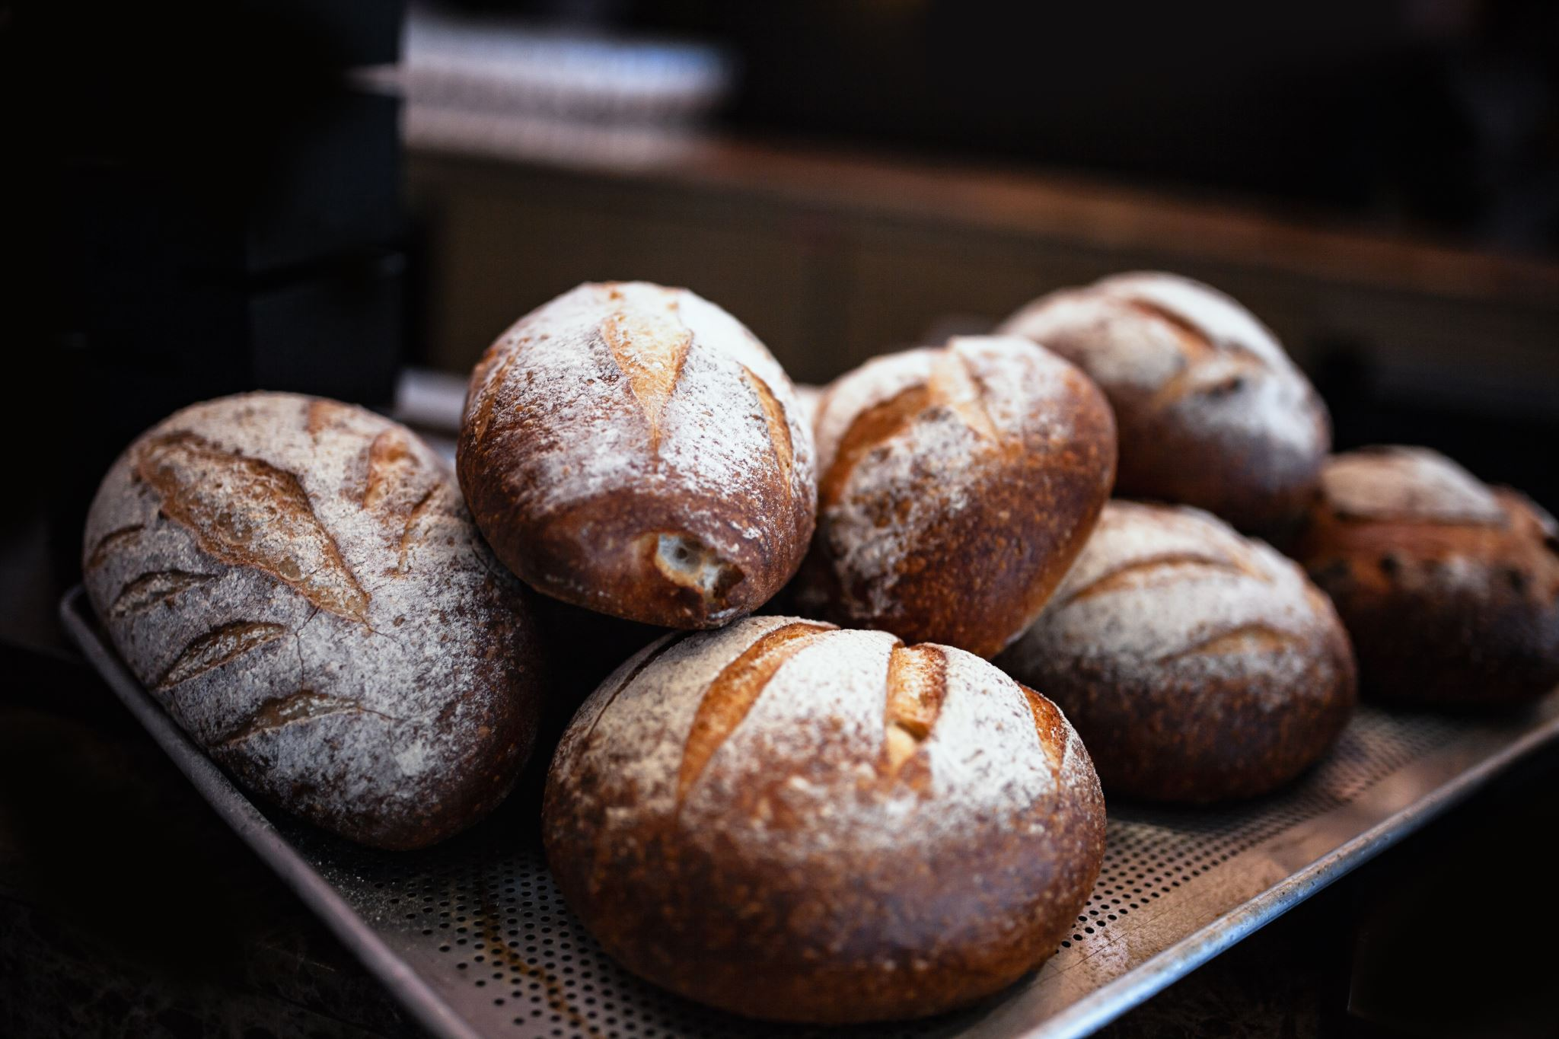

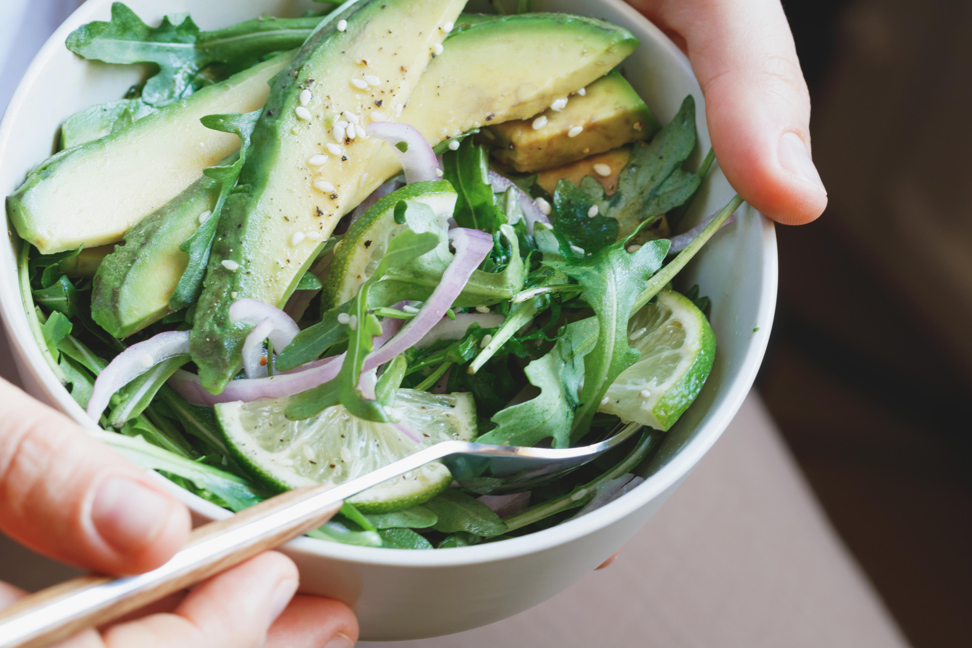

Recipes
Profile
Recipes
Ingredients
Schedule
Cart
Recipes
Filter
Recipes
Search
Creator
info
Bread
Ingredients
Build-in
Salamone sushi
Ingredients
Build-in
Green salad
Ingredients
Creator
info
Muffins
Ingredients

Slide 4


Profile
Recipes
Ingredients
Schedule
Cart
Create your recipe:
Profile
Recipes
Ingredients
Schedule
Cart
Create your recipe:
User recipes
Filter
Name of the recipe :
User recipes
Type of meal
Create a recipe
Meat
Dairy
Parve
Mixed
Gluten free
Search
Bread
Delete recipe
Insert a picture
Ingredients
Will open text dialog to insert instructions
Insert instruction
Salamone sushi
Delete recipe
1….
Number of portions that we will receive :
Ingredients
Insert Nutritious value
Beef
Tofu
Milk
……..
……..
-Add an ingredient to the system
Green salad
Delete recipe
List the ingredients
number
Ingredients
Label to show the cost of the recipe
Muffins
Delete recipe
I would like to share my recipe
Ingredients
I would like to share my information
Save

Slide 5




We are directed to this page after we click “Ingredients” from the recipes page
Profile
Recipes
Ingredients
Schedule
Cart
The number of portions we will receive from making that recipe
Ingredients for : “Salamone sushi”
Number of portions : 5
Parve
Nutritious value
Total cost
Ingredients :
Rice – 750 gram
The cost
Carrot – 150 gram
The cost
The cost
This will be a button that by clicking it – it will open a dialog showing the nutritious value for the entire recipe like amount of protein, carbs, fat
Salamone – 500 gram
Instruction :
*** Here will be presented how to make the dish step by step” ***
Copy & Edit

Slide 6

Profile
Recipes
Ingredients
Schedule
Cart
Profile
Recipes
Ingredients
Schedule
Cart
After clicking “copy & edit”
Create your recipe:
Create your ingredient:
Create your recipe:
Create your ingredient:
Name of the recipe :
Salamone sushi
Name of the recipe :
Salamone sushi
Parve
Parve
Insert a picture
Insert a picture
Insert instruction
The cost of the ingredient per 100 gram:
5
0.85$
Number of portions that we will receive :
Insert Nutritious value
Nutritious value
winter
List the ingredients
Rice – 750 gram
Carrot – 150 gram
Label to show the cost of the recipe
Salamone – 500 gram
How to store
I would like to share my recipe
I would like to share my recipe
I would like to share my information
Save
I would like to share my information
Save

Slide 7
Add ingredient:
Profile
Recipes
Ingredients
Schedule
Cart
Add ingredient
Add an ingredient :
Name of the ingredient :
Type of ingredient
This is a button that will open a text dialog that the user will insert the nutritious value of the ingredient
Meat
Dairy
Parve
Gluten free
Insert a picture
A text dialog will be open in order to write how to store the ingredient in big quantities
The cost of the ingredient per 100 gram:
Nutritious value
Season
To list the season that we can get that ingredient
Winter, autumn, summer, spring, any (in all).
How to store
I would like to share my ingredient
I would like to share my information
Save

Slide 8



List of client ingredient:
Profile
Recipes
Ingredients
Schedule
Cart
We will direct the user to add ingredient page
List of user ingredients
Filter
User ingredients:
Add an ingredient
Eggplant
Information
Delete ingredient
Filter- meat, diary, parve, gluten free
Avocado
Information
Delete ingredient
Strawberry
Information
Delete ingredient
We cannot delete ingredients that are build-in in the system
Banana
Information
Delete ingredient

Slide 9
Ingredients
Profile
Recipes
Ingredients
Schedule
Cart
ingredients:
Filter
Ingredients:
Eggplant
Creator
info
Information
Avocado
Build-in
Information
Strawberry
Creator
info
Information
Banana
Creator
info
Information

Slide 10



Event
Create an event
Profile
Recipes
Ingredients
Schedule
Cart
Profile
Recipes
Ingredients
Schedule
Cart
Event
Event
Event
Create an event
Create your event :
Pizza night
Information
Delete Event
Event name:
Pick a date
Purim party
Information
Delete Event
Insert a picture:
Sivan’s birthday
Information
Delete Event
List the recipes
 | price | quantity | name | picture
 | 12.5 $ | 5 | Salamone sushi
 | 22$ | 3 | Muffins
Elad’s birthday
Information
Delete Event
info
info
Total price 34.5$
Save

Slide 11


Daily schedule
Create daily schedule
Profile
Recipes
Ingredients
Schedule
Cart
Profile
Recipes
Ingredients
Schedule
Cart
Daily schedule
Daily schedule
Daily schedule
Create daily plan
Create your daily schedule :
Option 1
Information
Edit
Date
Delete
Breakfast:
List the recipes
number
Option 2
Edit
Delete
Information
Date
Lunch:
List the recipes
number
Dinner:
List the recipes
number
Option 3
Information
Edit
Date
Delete
 | price | name | picture | category
 | 5.25$ | Berries corn flex |  | breakfast
 | 3.75$ | Salamone sushi |  | lunch
 | 10$ | fish |  | dinner
info
Option 4
Information
Edit
Date
Delete
info
info
Total price 29$
Save

Slide 12
Weekly schedule
Create Weekly schedule
Profile
Recipes
Ingredients
Schedule
Cart
Profile
Recipes
Ingredients
Schedule
Cart
weekly schedule
weekly schedule
Weekly schedule
Create weekly plan
Create your weekly schedule :
Option 1
Information
Edit
Date
Delete
Create / pick from daily
Sunday
Saturday
Create / pick from daily/ event
Option 2
Information
Edit
Date
Delete
 | price | category
 | 23$ | Sunday
….. | …. | ….
 | 32.5$ | Saturday
Option 3
Information
Edit
Date
Delete
info
Option 4
Information
Edit
Date
Delete
info
Total price : X
Save

Slide 13
Monthly schedule
Create Monthly schedule
Profile
Recipes
Ingredients
Schedule
Cart
Profile
Recipes
Ingredients
Schedule
Cart
Monthly schedule
Monthly schedule
Monthly schedule
Create monthly plan
Create your monthly schedule :
Option 1
Information
Edit
Date
Delete
Create / pick from weekly
Week 1:
Week 4:
Create / pick from weekly
Option 2
Information
Edit
Date
Delete
 | price | category
 | 213$ | Week 1
….. | …. | ….
 | 122.5$ | Week 4
Option 3
Information
Edit
Date
Delete
info
Option 4
Information
Edit
Date
Delete
info
Total price : X
Save

Slide 14
Yearly schedule
Create yearly schedule
Profile
Recipes
Ingredients
Schedule
Cart
Profile
Recipes
Ingredients
Schedule
Cart
Yearly schedule
Yearly schedule
Yearly schedule
Create Yearly plan
Create your Yearly schedule :
Option 1
Information
Edit
Date
Delete
Create / pick from monthly
month 1:
month 12:
Create / pick from monthly
Option 2
Information
Edit
Date
Delete
 | price | category
 | 613$ | Week 1
….. | …. | ….
 | 978.30$ | Week 4
Option 3
Information
Edit
Delete
info
Option 4
Information
Edit
Delete
info
Total price : X
Save

Slide 15
Upcoming schedule
Profile
Recipes
Ingredients
Schedule
Cart
Here we will present the schedule by the date the user set for them. Note that the schedule will also be presented in each page they were set to. For example, the daily schedule will present those 2 schedule here as well, because the user might want to use them
Upcoming schedule
Upcoming schedule
12.11.20
Daily Plan
Information
Delete
13.12.20
Daily Plan
Information
Delete
1.12.20
Monthly Plan
Information
Delete
12.12.20
Event Plan
Information
Delete

Slide 16
Profile
Recipes
Ingredients
Schedule
Cart
10/01/2021 | 11/01/2021 | 12/01/2021 | 13/01/2021 | 14/01/2021 | 15/01/2021 | 16/01/2021
17/01/2021 | 18/01/2021 | 19/01/2021 | 20/01/2021 | 21/01/2021 | 22/01/2021 | 23/01/2021
24/01/2021 | 25/01/2021 | 26/01/2021 | 27/01/2021 | 28/01/2021 | 29/01/2021 | 30/01/2021
We can click a date and then we will open a daily page to pick a daily schedule/ or if we pick a week then we open a weekly schedule

Slide 17


Profile
Recipes
Ingredients
Schedule
Cart
Profile
Recipes
Ingredients
Schedule
Cart
profile
Edit profile
Edit profile :
Hello Alice!
First name:
Last name:
5
Email:
Number of shared recipes :
12
Number of shared ingredients :
Insert a picture:
Total cost of items in the cart :
425.23$
Edit profile
Logout
Save

